Slide 1


Applying Hand Gesture Recognition
for User Guide Application Using MediaPipe and OpenCV

Slide 2
Content
Abstract
Introduction
Motivation
Problem Statement
Area of Application
Literature Review
SWOT Analysis
Objectives
Methodology
Algoritm
Working Model
Conclusion
References

Slide 3
Abstract
The use of a physical controller like mouse, keyboard for human computer interaction hinders natural interface as there is a strong barrier between the user and computer. Here, we have designed a hand gesture recognition system which can efficiently track both static and dynamic hand gestures. The proposed system translates the detected gesture into actions such as using a whiteboard on the video screen itself and other such features to help the user. The dynamic gesture is used to shuffle through the slides in presentation. The result obtained shows that an intuitive HCI can be achieved with minimum hardware requirements.

Slide 4
Introduction
Interactive presentation systems use advanced Human Computer Interaction (HCI) techniques to provide a more convenient and user-friendly interface for giving commands to the machine, such as page up/down controls, open menu, exit app, etc.
Users can interact with computer at any time, and it has less constraint on users, enabling computers to accurately and timely understand user’s instruction.
The instructions do not require any mechanical assistance making the whole process efficient in an overall manner.
Input units have been a major part of computing machines, however technology has much more to offer. The proposed project believes in the idea of making the process of giving inputs to machine more time efficient as well as an effective process which will decrease the gap between input and output cycle providing a more user friendly interface that is also capable of customization for special needs of situation as well as user.

Slide 5
Introduction (Cont...)
People can communicate with machines more naturally with computer vision-based gesture recognition.
It is also a sustainable method as it is less affected by the environment.
Users can interact with computer at any time, therefore it has less constraint on users, enabling computers to accurately and timely understand user’s instruction making the whole process way faster and time efficient. These instructions do not require any mechanical assistance. Gestures are timely, vivid, intuitive, flexible and visual in the process of human computer interaction. They can soundlessly complete interaction and successfully break the gap between reality and virtual.

Slide 6
Motivation
There are many applications where hand gesture can be used for interaction with systems like, videogames, controlling UAV’s, medical equipment’s, etc. These hand gestures can also be used by handicapped people to interact with the systems. Classical interactions tools like keyboard, mouse, touchscreen, etc. may limit the way we use the system. All these systems require physical contact, in order to interact with system.
Gestures can interpret same functionality without physically interacting with the interfacing devices. The problem lies in understanding these gestures, as for different people, the same gesture may look different for performing the same task. This problem may be overthrown by the use of mediapipe and opencv are proving to be ultimate tool to process such recognition systems. High computing power is required in order to process gestures.

Slide 7
Problem Statement
With the recent advancement of technology, current user interaction still uses keyboard, mouse and pen that are sufficient but not much user friendly now, due to the limitation of these devices (useable command set is also limited).
Hence, this software is an attempt to create a system which can identify specific human hand gestures and use them to convey information or for device control using convolutional neural networks.
Also in this period, these technologies take way more costly devices to setup properly like high frame camera, Hand Gloves , high tuned system , body suit, etc.

Slide 8
Area of Application
This software can be used by teachers for the purpose of online learning and have a better interactive bonding with students.
It can be used to control the distribution of resources in hospitals, interact with medical instrumentation, control visualization displays, and help handicapped users as part of their rehabilitation therapy.
It can be utilized in the Virtual Reality Systems as commanding gesture can help better interactivity than some appliances which has selective uses.

Slide 9
Literature Review
Early gesture recognition directly detected the position of each joint of the human hand with Wearable devices, and transmitted the information to the computer through wired transmission, accurately storing the user's hand motion information. It doesn't mean that these devices are the most convenient for most users. Since ancient times, gestures have been used for communication and interaction. Before the invention of language, people could easily express the idea by gestures.
Data Gloves and other equipment are expensive and inconvenient to use. Data Glove was displaced by the optical marking method because it used IR light to detect the position and hand movement of the human hand. It also has a good effect, but still requires more complicated equipment. Although higher accuracy can be obtained by the help of external devices, it is expensive and affects the user's actions to some extent. The gesture recognition based on computer vision refers to the processing of the video data collected by the camera through the gesture recognition algorithm, which achieves the purpose of gesture recognition and has become a research hotspot in recent years.

Slide 10
Literature Review (Cont...)
In the past decades the social life and computer interactions has been a huge breakthrough and complying to find something more specific to each functionality as the interactive components/ devices(smartphones, games, infotal inment systems) has been upgrading and complexed, has been an important issue. In these times we gesture control techniques has become a new development trend in every possible computer-based interactions such as games for instance; The VR headsets and other such devices such as data gloves and motion sensors; Through these equipment or such techniques user can interact with the machines based on the movements of these devices more naturally than using a traditional devices such as joysticks or keyboards or a mouse.
Domestic computer vision-based gesture recognition has also achieved certain achievements. The proposed method of gesture recognition using apparent changes in image transformation, and used variational parameter model of image motion to identify 120 gestures. There has been another method proposed to solve dynamic gesture recognition through self-learning sparse representation. This method directly processes the original image without feature extraction and real-time processing and other such methods using fingures detection through SVMs to narrow down the possible number of inputs

Slide 11
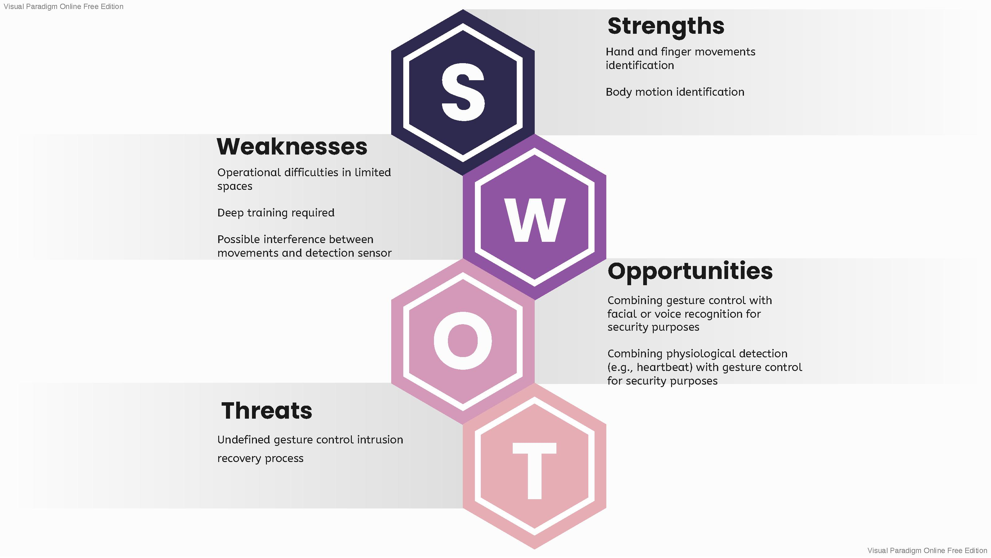
SWOT Analysis:

Slide 12
Objective
Controlling Computer Devices via Gesture Recognition System has various uses which also include using multi-tasking task completion. This technique can be used with various project and in various ways according to one’s imagination and needs as this method is flexible and highly customizable.
The practice can bring significant changes into online teaching methods by providing teachers tools that are easily accessible and students a more real time experience. Some features accessed by gestures :
Markers that can draw on the screen using finger
Erasers to clear the screen
Sharing various types of file formats on screen
Menu accessed by hand gestures
Online board to write on with hand gestures, etc.

Slide 13
Objective
Using body gestures to provide commands to the computing machine reduces the gap between reality and machine world which further makes the experience of the user more extraordinary and real. Because of the usability of gesture recognition, this idea and its algorithms can be used in many other areas like game consoles, tablet PC’s etc., Virtual Realities and so on.
Moreover, the major parameters of this technology such as customization and minimization of input devices can be used to create interfaces for specially abeled people, older population or younger children who are new to technology.

Slide 14
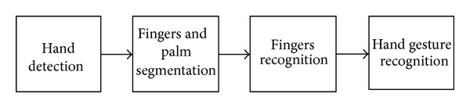
Methodology
The model of this project can be describe into different phases
1. Extracting video frames using OpenCV
First importing OpenCV, it will access the camera and start taking the video frame by frame.
Now the variable is storing the first frame and sending it to the thread made from mediapipe so the it can read the frame using stream.read() function.
Here is how reading frame works:
2. Reading the Frame using Mediapipe
While reading the first frame it captured, mediapipe solution will detect the hand as this is a well trained framework. After that it will make the landmarks on the palm, elbow and shoulders and providing a defined name and number to that landmarks.

Slide 15
Methodology
3. Commands using conditions
Now after storing the updated frame, conditions can be use to give suitable commands to the programe. These conditions and landmarks can be used to provide various outputs according to the user.

Slide 16
Algorithm
Mediapipe
MediaPipe offers open source cross-platform, customizable ML solutions for live and streaming media.
Mediapipe Framework
Today, there are many frameworks or libraries of machine learning for hand gesture recognition. One of them is MediaPipe. The MediaPipe is a framework designed to implement production-ready machine learning that must build pipelines to perform inference over arbitrary sensory data, has published code accompanying research work, and build technology prototypes . In MediaPipe, graph modular components come from a perception pipeline along with the function of inference model function, media processing model, and data transformations. Graph of operations are used in others machine learning such as Tensor flow , MXNet, PyTorch[, CNTK, OpenCV 4.0.
Using MediaPipe for hand gesture recognition has been researched , before, using a single RGB camera for AR/VR application in a real-time system that predicts a hand skeleton of the human. We can develop a combined MediaPipe using other devices.

Slide 17
Algorithm
The MediaPipe implements pipeline consists of two models for hand gesture recognition as follows :
1. A palm detector model processes the captured image and turns the image with an oriented bounding box of the hand,
2. A hand landmark model processes on cropped bounding box image and returns 3D hand key points on hand.
3. A gesture recognizer that classifies 3D hand key points then configuration them into a discrete set of gestures.

Slide 18
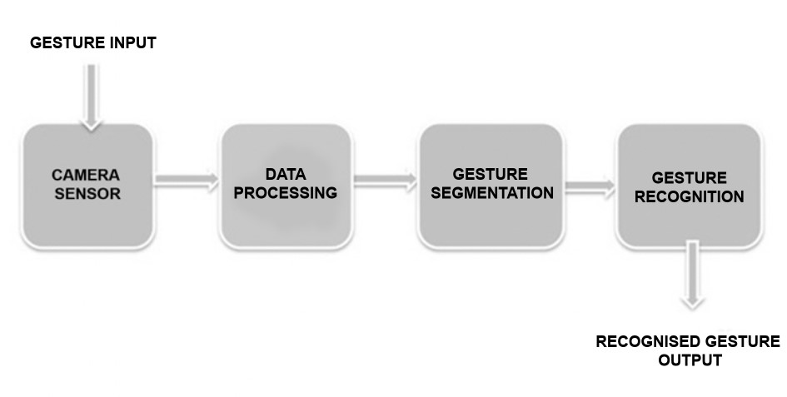
Methodology Chart

Slide 19
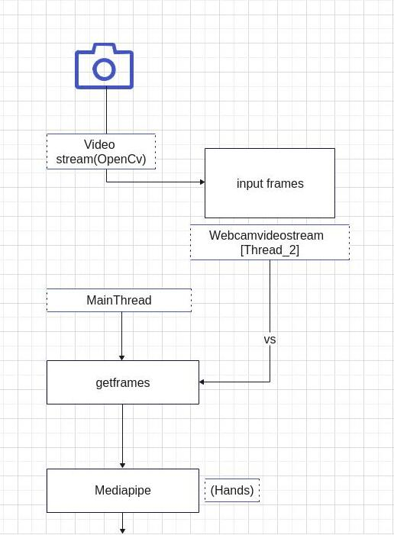
Design Diagram

Slide 20
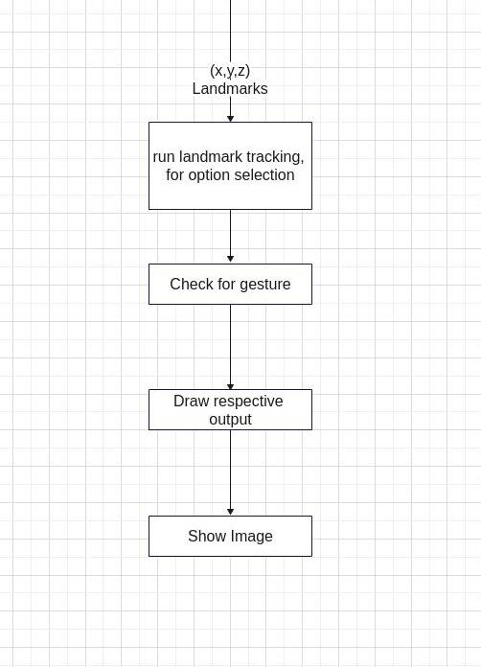
Design Diagram

Slide 21
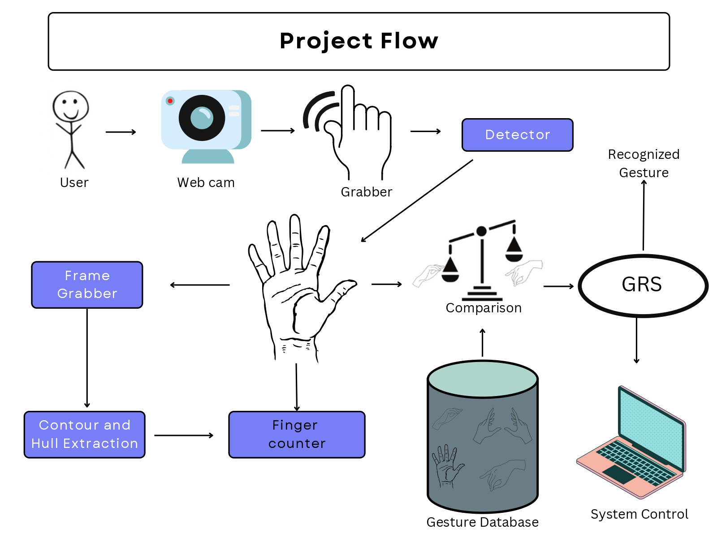
Abstract Diagram:

Slide 22
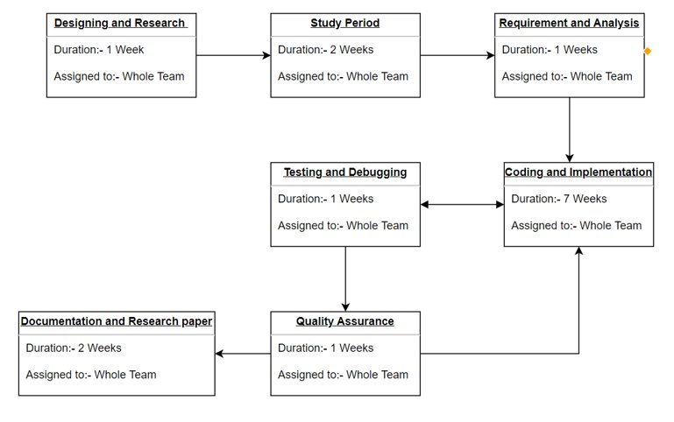
Pert Chart

Slide 23
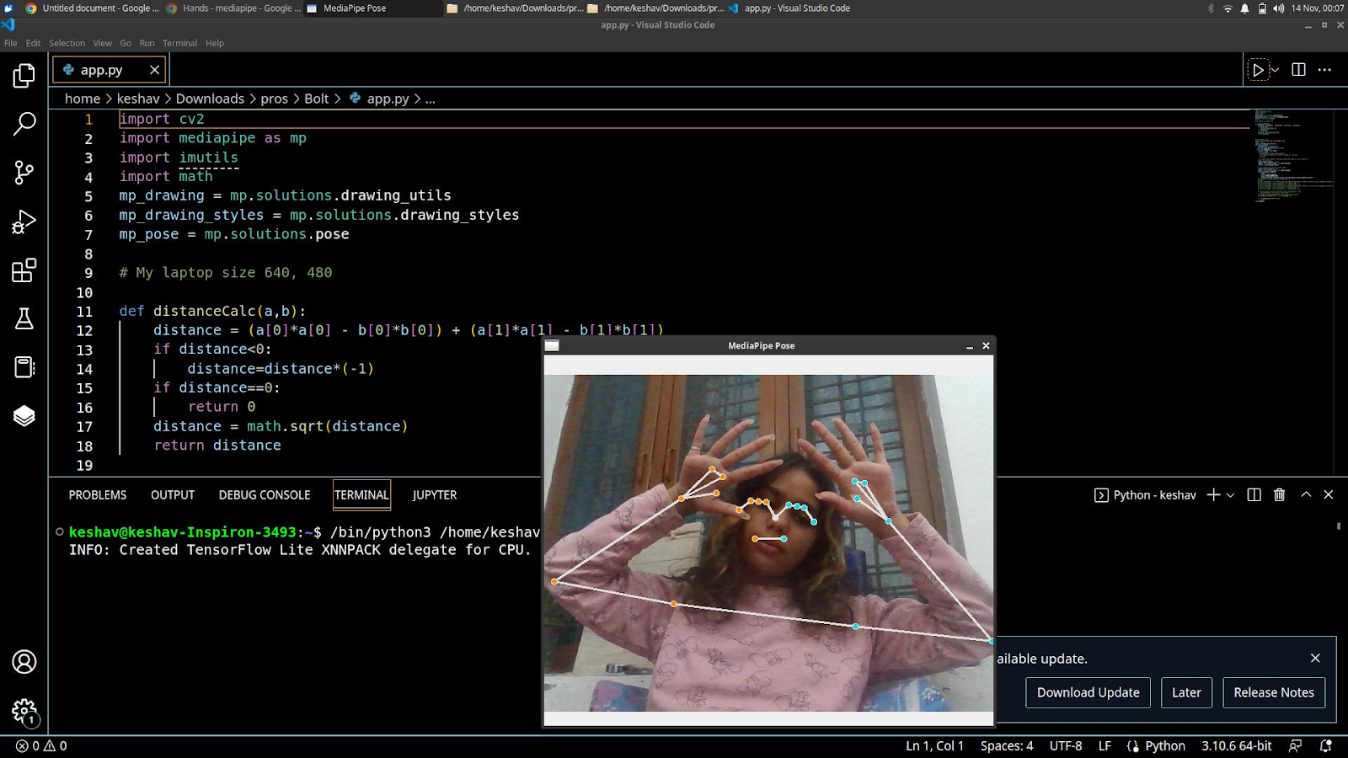
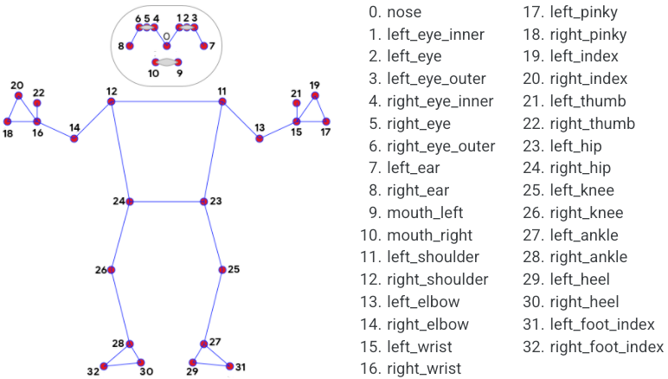
Working Model :
Body/Object Detection

Slide 24
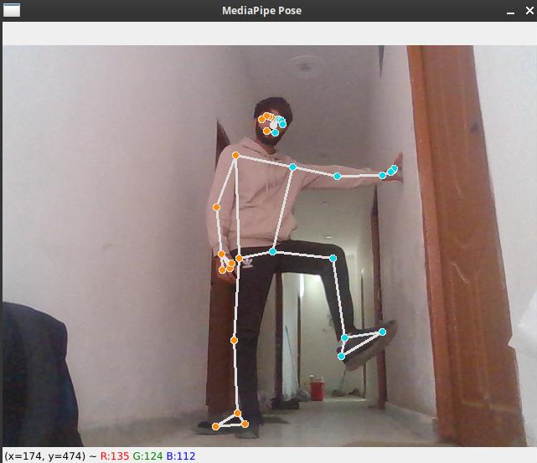
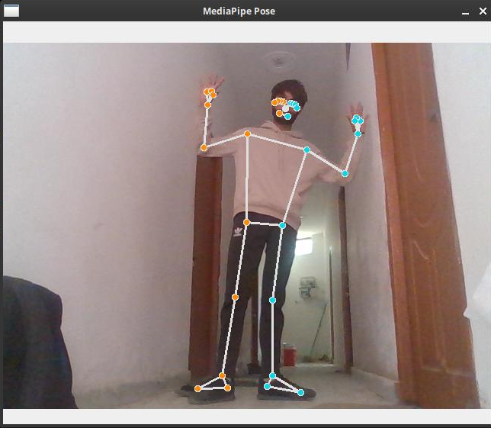
Working Model:
Pose Estimation/Joints Curls counter

Slide 25
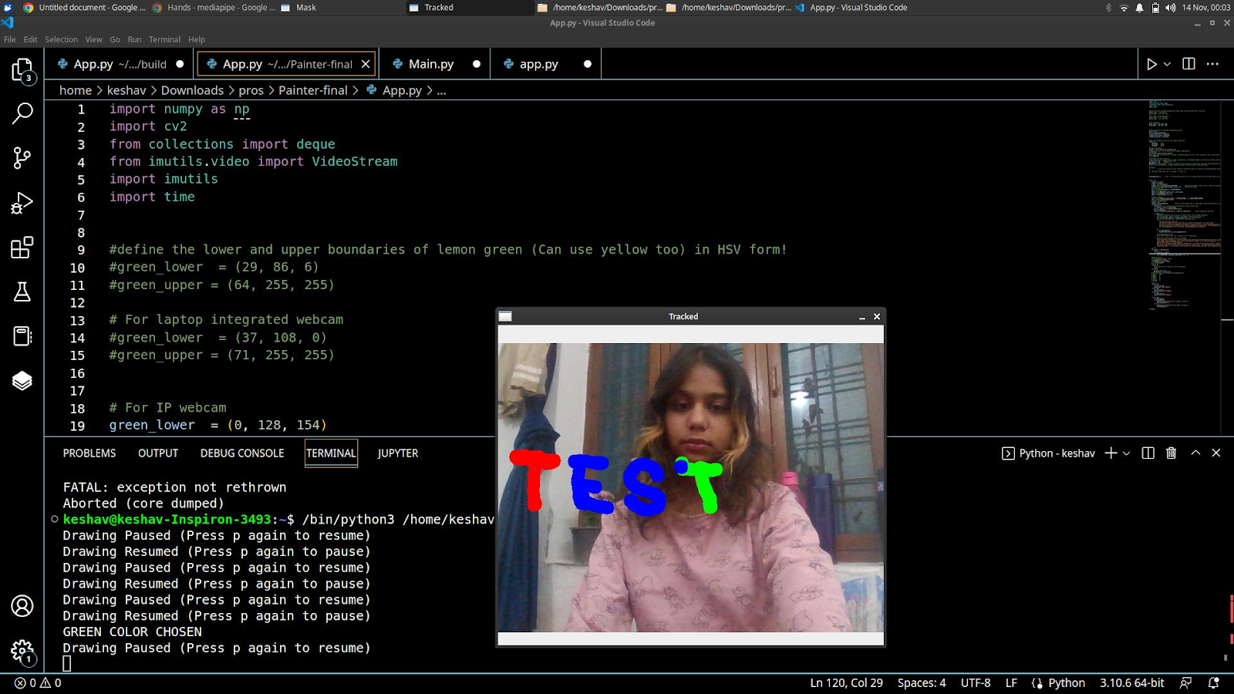
Working Model:
On Screen AI Painter

Slide 26
Conclusion
Gesture recognition technology is the turning point of the world in technical advancement. It can allow seamless non-touchable control of computerized devices to create a highly interactive, yet fully immersive and flexible hybrid reality. The inclusion of this technology in multiple applications across various sectors is further revolutionizing human-computer communication. That said, gesture recognition is no novice’s game.
It’s a fully integrated, highly advanced technology that requires specialized skills of individuals with relevant experience that can guarantee favorable results. This software is a development with the resources, talents, and expertise of our proficient and dedicated team members who can recognize and understand humans requirements and successfully deliver to the expectations. This software can help people realize that their imagination can be a reality.

Slide 27
Reference
[1] Ustunug A, Cevikcan, Industry 4.0: Managing The Digital Transformation, Springer Series in Advanced Manufacturing, Switzerland. 2018. DOI: https://doi.org/10.1007/978-3-319-57870-5.
[2] Hamed Al-Saedi A.K, Hassin Al-Asadi A, Survey of Hand Gesture Recognition System. IOP Conferences Series: Journal of Physics: Conferences Series 1294 042003. 2019. DOI: https://doi.org/10.1088/1742-6596/4/042003.
[3] S.Rautaray S, Agrawal A. Vision Based Hand Gesture Recognition for Human Computer Interaction: A Survey. Springer Artificial Intelligence Review. 2012. DOI: https://doi.org/10.1007/s10462-012-9356-9.
[4] Lugaresi C, Tang J, Nash H, McClanahan C, et al. MediaPipe: A Framework for Building Perception Pipelines. Google Research. 2019. https://arxiv.org/abs/2006.10214.
[5] C.Chua, H. Guan, Y.Ho, Model-Based 3D Hand Posture Estimation From a Single 2D Image. Image and Vision Computing vol.20, 2002, pp. 191-202.
[6] M.Panwar, Hand Gesture Recognition Based on Shape Parameters, In International Conferences: Computing Communication and Application (ICCCA), 2012.

Slide 28
Reference
[7] Marco Maisto, An Accurate Algorithm for Identification of Fingertips Using an RGB-D Camera, IEEE Journal on Emerging and Selected Topics in Circuits and System, 2013. pp. 272-283.
[8] Wu Xiayou, An Intelligent Interactive System Based on Hand Gesture Recognition Algorithm and Kinect, In 5th International Symposium on Computational Intelligence and Design.2012
[9] Lugaresi C, Tang J, Nash H et.al, MediaPipe: A Framework for Perceiving and Processing Reality. Google Research. 2019.
[10] Abadi M, Barham P, Chen J et.al, Tensorflow: A System for Large-Scale Machine Learning, In 12th USENIX Symposium on Operating System Design and Implementation (OSDI), USA, 2016,
https://www.usenix.org/conference/osdi16/technica l-sessions/presentation/abadi.
[11] Matveev D, OpenCV Graph API. Intel Corporation. 2018.
[12] Zhag F, Bazarevsky, Vakunov A et.al, MediaPipe Hands: On – Device Real Time Hand Tracking, Google Research. USA. 2020.
https://arxiv.org/pdf/2006.10214.pdf.
[13] MediaPipe: On-Device, Real Time Hand Tracking, In https://ai.googleblog.com/2019/08/on-devicereal-time-hand-tracking-with.html. 2019. Access 2021.
[14] Grishchenko I, Bazarevsky V, MediaPipe Holositic – Simultaneoue Face, Hand and Pose Prediction on Device, Google Research, USA, 2020, https://ai.googleblog.com/2020/12/mediapipeholistic-simultaneous-face.html, Access 2021.
[15] MediaPipe Github:
https://google.github.io/mediapipe/solutions/hands. Access 2021.

Slide 29
Reference
[13] MediaPipe: On-Device, Real Time Hand Tracking, In https://ai.googleblog.com/2019/08/on-devicereal-time-hand-tracking-with.html. 2019. Access 2021.
[14] Grishchenko I, Bazarevsky V, MediaPipe Holositic – Simultaneoue Face, Hand and Pose Prediction on Device, Google Research, USA, 2020, https://ai.googleblog.com/2020/12/mediapipeholistic-simultaneous-face.html, Access 2021.
[15] MediaPipe Github:
https://google.github.io/mediapipe/solutions/hands. Access 2021.

Slide 30
Thank You

